Slide 1

Statistical Computation Methods for Data Science
Unit-I
Lecture - 5
S U RAVI KUMAR CHAVALI
Assistant Professor
Department of Science and Humanities
SNIST

Slide 2
We discuss the following in today’s Lecture
Measures of Central Tendency
Geometric mean
Harmonic mean (H.M)

Slide 3
Geometric mean
For Ungrouped Data,
The geometric mean of a series containing n observations is the nth root of the product of the
values. If x₁, x₂, ……………x_{n} are n observations then

Slide 4
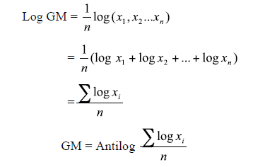
Geometric mean
Note: GM is used in studies like bacterial growth, cell division, etc.

Slide 5
Geometric mean
For Grouped Data,
Let the given data be
Then, Geometric Mean is given by
x: | x₁ | x₂ | - | - | x_{n}
f: | f₁ | f₂ | - | - | f_{n}

Slide 6
If Class Interval frequency distribution is given then, Geometric Mean is given by,
Where x_{i} is the mid value of the class interval.

Slide 7
Example 1
If the weights of sorghum ear heads are 45, 60, 48,
100, 65 gms. Find the Geometric mean for the
given data.
Solution: Here the given data is ungrouped, then the Geometric mean is given by,

Slide 8
Example 1 Solution cont..
OR

Slide 9
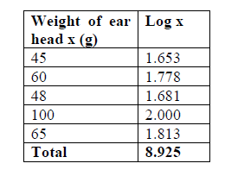
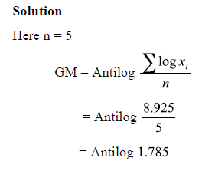

Example 1 Solution

Slide 10
Example 2
Find the Geometric mean for the following
Weight of sorghum(x) | 50 | 63 | 65 | 130 | 135
No. of ear head(f) | 5 | 10 | 5 | 15 | 15

Slide 11
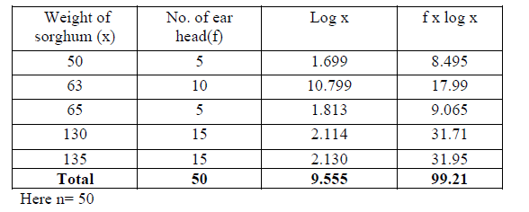
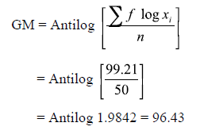
Solution:

Slide 12
Example 3
For the frequency distribution of weights of sorghum ear-heads given in table below.
Calculate the Geometric mean
Weights of ear heads ( in g) | 60-80 | 80-100 | 100-120 | 120-140 | 140-160
No of ear heads (f) | 22 | 38 | 45 | 35 | 20

Slide 13
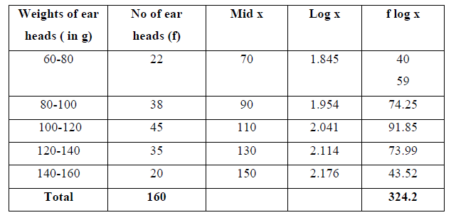
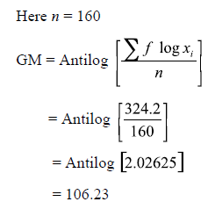
Solution:

Slide 14
Harmonic mean (H.M)
For Ungrouped Data,
Harmonic mean of a set of observations is defined as the reciprocal of the arithmetic average of the reciprocal of the given values.
If x₁, x₂, ……………x_{n} are n observations then

Slide 15
Harmonic mean (H.M)
For Grouped Data,
Let the given data be
Then, Harmonic Mean is given by
x: | x₁ | x₂ | - | - | x_{n}
f: | f₁ | f₂ | - | - | f_{n}

Slide 16
If Class Interval frequency distribution is given then, Harmonic Mean is given by,
Where x_{i} is the mid value of the class interval.
Note: H.M is used when we are dealing with speed, rates, etc.

Slide 17
Example 1
From the given data 5, 10,17,24,30 calculate H.M.
Solution:
x | 1/x
5 | 0.2000
10 | 0.1000
17 | 0.0588
24 | 0.0417
30 | 0.0333

Slide 18
Example 2
Number of tomatoes per plant are given below. Calculate the harmonic mean.
No. of tomatoes per plants | 20 | 21 | 22 | 23 | 24 | 25
No. of plants | 4 | 2 | 7 | 1 | 3 | 1

Slide 19
Solution:
No. of tomatoes per plants(x) | No. of plants(f)
20 | 4 | 0.0500 | 0.2000
21 | 2 | 0.0476 | 0.0952
22 | 7 | 0.0454 | 0.3178
23 | 1 | 0.0434 | 0.0434
24 | 3 | 0.0416 | 0.1251
25 | 1 | 0.0400 | 0.0400
Total | 18 |  | 0.8216

Slide 21
Example 3
Calculate the Harmonic mean
C I | 60-80 | 80-100 | 100-120 | 120-140 | 140-160
Frequency | 22 | 38 | 45 | 35 | 20

Slide 22
Answer:
=103.426

Slide 23
Recapitulation:
Measures of Central Tendency
Geometric Mean
Harmonic Mean

Slide 24

Thank you all
25 July 2019

